Slide 1
BA MM TEam
Change Control Process

Slide 2
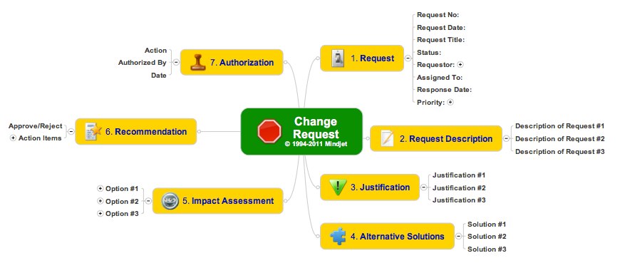

Slide 3
Contents
Topics
Change Control Board
- Purpose / Guidelines
- Members
- Change Request Form
- Change Request Log
- Change Request Process
Solution Design
- Objectives
- Members

Slide 4
Purpose
Large programs will inevitably need to manage change during the life of the projects involved. Unforeseen changes in timing, technology and cost can have large impacts on projects. If not managed properly, Programs will lose focus and never succeed.
The Change Control Board (CCB) is a group responsible for making decisions to accept or reject proposed changes to the Program or Project in regards to Scope, Timeline or Budget.

Slide 5
Guidelines
There will be a single Change Control Process and CCB for the Enterprise Roadmap program and all underlying projects.
If a change request is brought by a UL employee not on the extended program team, then the proposed changes is recommended to be evaluated by Geo/BU-representative program team member prior to formal submission.
The Geo/BU-representative will submit the Change Request on behalf of the change requestor.
A Change Control Form is required to be completed for any requested change. The form documents the change requested and outlines the overall benefits gained.
Impact assessments are required to be completed prior to the CCB reviewing an individual change.
The CCB is comprised of the two in a box Project Leads, Solution Architect, Project Controller and members of the PMO.
The board meets as needed to review proposed changes to any part of the overall Enterprise Roadmap Program.
The CCB has overall authority to Accept, Defer, or Reject proposed changes.
Requested escalations based on CCB decisions will be handled by the PMO and Program Leadership, engaging the Steering Committee as required.

Slide 6
Change Request Log
All Requests for Change are to be documented in the Change Request Log
The log includes information on when the change request was received, who submitted the request, Outcome (Accepted/Deferred/Rejected), decision date, etc.
The Change Request Log is available on SlACK (for now)

Slide 7
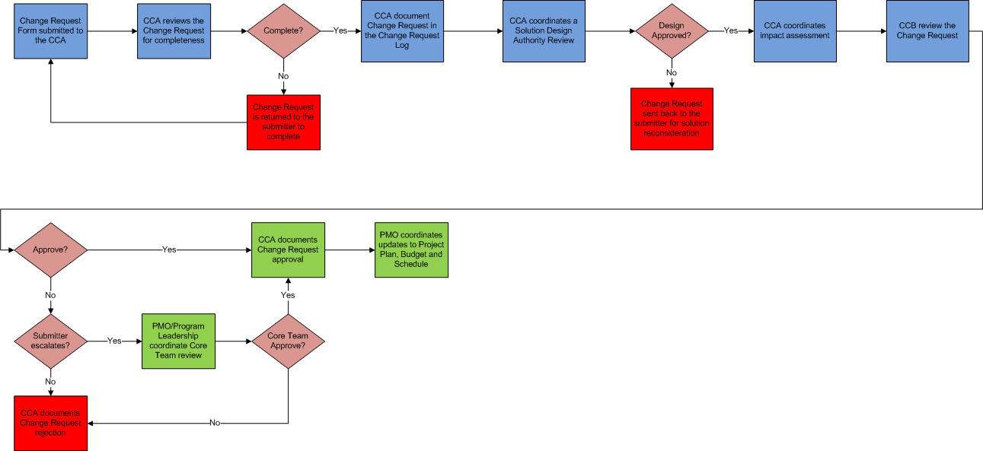
Change Request Process

Slide 8
Solution Design Authority Objectives
Serve as process, application, and technology experts, providing guidance with respect to best practices and standards that are applicable to the program.
Evaluate implications to the implementation scope based on submitted change requests.
Support the impact analysis of change requests by establishing the to-be solution for potential enablement through processes, applications, and technology.
Decisions required for process, information or technology changes are provided by the Global Business Council.

Slide 9
Solution Design Authority - Members
Role | UL Member | Infosys Member | R | A | C | I
Architecture Lead | Dan Lichter | Neeraj Mahajan | X | X
Technology Lead | Scott Osterman | Rob Pierson | X
Technology Module Leads | TBD | TBD | X
Business Process Leads | TBD | TBD | X
Business Process Analysts | TBD | TBD |  |  | X
Q2C Director | Mike Rubin | Kenneth Barry |  |  | X
Fulfillment Director | Rich Martin | Vivek Vivek |  |  | X
Information Director | Surekha Durvasula | Mike Rice |  |  | X

